Slide 1











IEEE NSUT
HACK4DELHI
Pitch Directly to the Government. Build for the Nation.
Members name and Affiliation:
Team Name : NeuralX
(Open Innovation AI & Civic Tech)
ANKUR-UIET MDU
RAKSHA-WCTM GURUGRAM
RONAK SHARMA-UIET MDU
MUSKAN KUMARI-UIET MDU
AREEBA KULSUM-DITM FARIDABAD

Slide 2

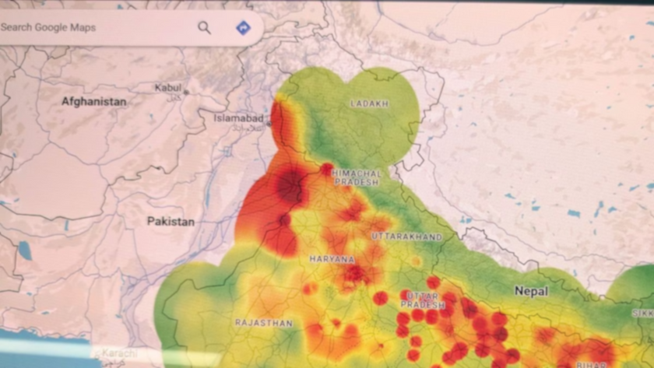


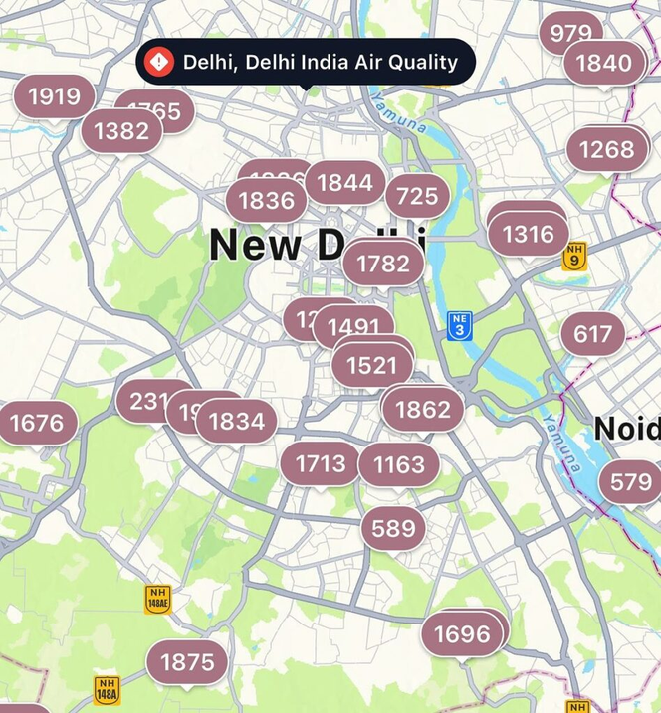

PROBLEM STATEMENT
IEEE NSUT
Real-World Challenge
Urban pollution data is mostly city-level or zone-level
Pollution sources vary ward to ward
One-size-fits-all policies fail at local execution
Existing Gaps
No real-time ward-wise visibility
Citizens lack localized awareness
Authorities lack action-priority insights
Data exists, but not decision-ready
Why This Matters
Delayed action increases health risks
Poor targeting wastes administrative effort
Lack of transparency reduces public trust

Slide 3
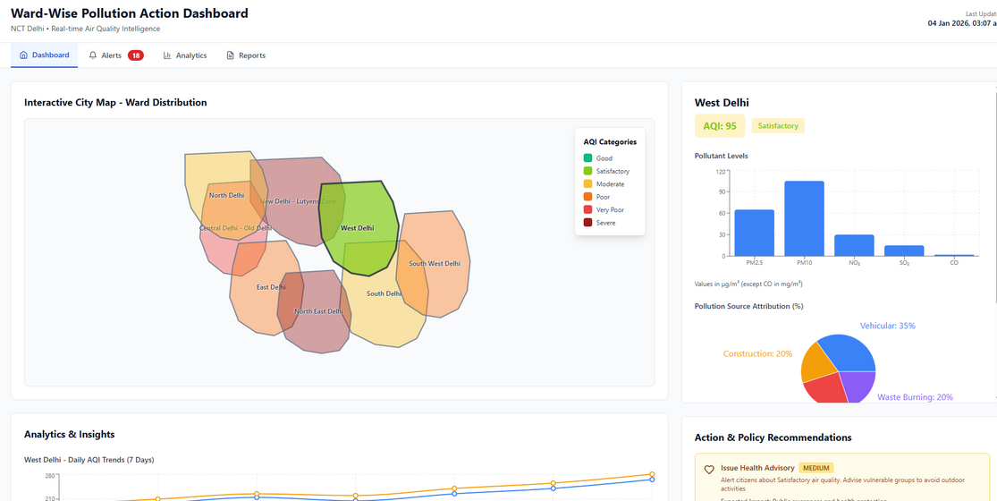
SOLUTION
IEEE NSUT
Our Approach
Aggregate pollution, traffic, weather, and citizen data
Analyze at ward granularity
Convert data into clear actions
What the Solution Delivers
Real-time ward pollution status
Source-wise pollution attribution
Citizen alerts & advisories
Authority-focused action recommendations
Why This Stands Out
Ward-first design (not city-first)
Action-oriented, not data-heavy
Built for both citizens & government

Slide 4
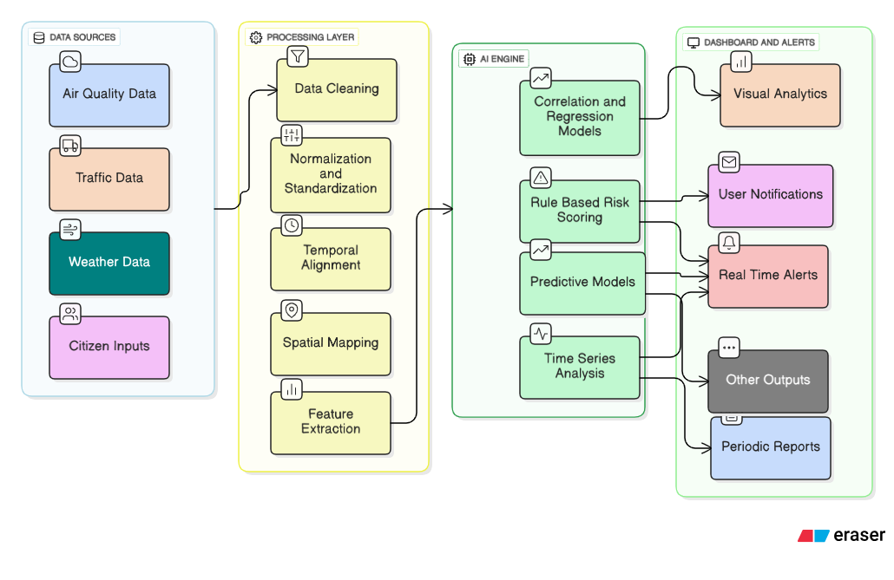
ARCHITECTURE
IEEE NSUT
System Architecture & Data Flow
Multi-source data ingestion (AQI, traffic, weather)
Preprocessing & normalization
AI-based pattern & risk analysis
Role-based dashboard delivery
Data Ingestion Layer
AI & Analytics Engine
Visualization & Alert Module

Slide 5
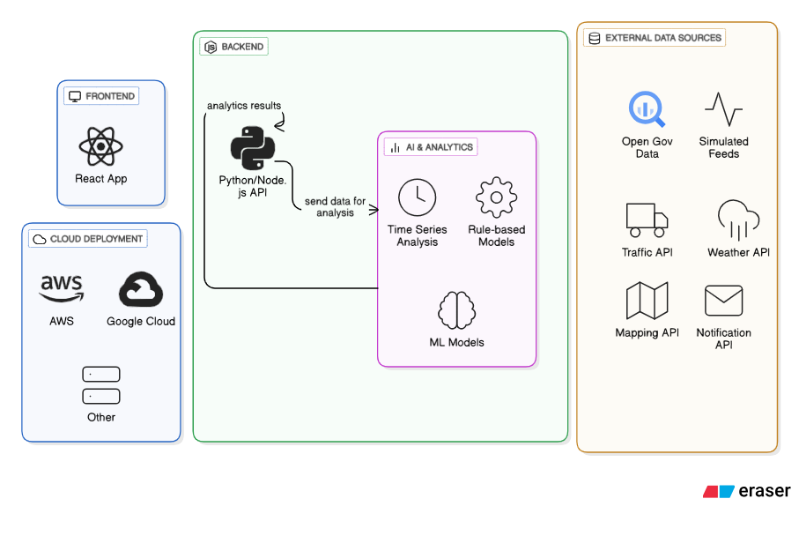
TECHNOLOGY USED

Slide 6
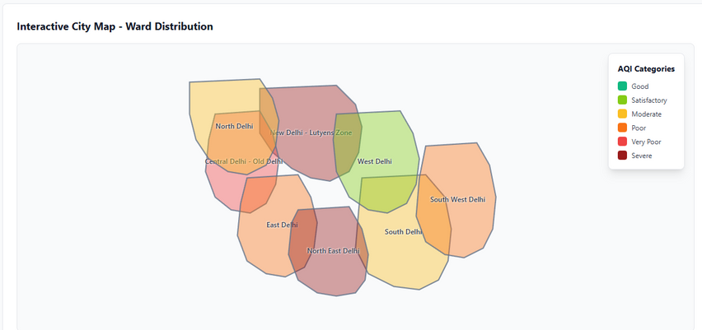
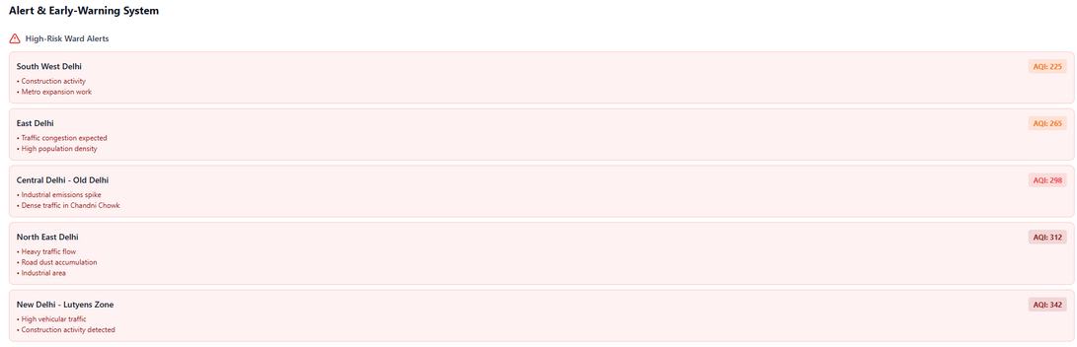
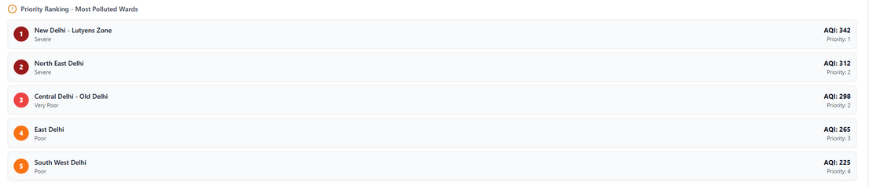
FEATURE/USP
Key Features & Unique Strengths
IEEE NSUT
Core Features
Ward-wise pollution heatmap
Source attribution (traffic, construction, weather)
Predictive pollution alerts
Citizen-friendly health advisories
Unique Selling Points (USP)
Ward-level governance focus
Dual-interface (citizen + authority)
Action-priority ranking
Low-cost, scalable architecture

Slide 7


REFERENCES/LINKS
IEEE NSUT
Content
CPCB AQI Data – https://app.cpcbccr.com
OpenAQ Platform – https://openaq.org
OpenWeather API – https://openweathermap.org/api
OpenStreetMap – https://www.openstreetmap.org
IEEE Xplore & Google Scholar (Research Papers)
GitHub Repository link
https://github.com/ANKUR172006/WARD-POLLUTION-DASHBOARD
DEMO VIDEO
https://drive.google.com/file/d/119GhUVHadu52MVlLpw4_4rv3ftjiY5MQ/view?usp=drivesdk

Slide 8







IEEE NSUT
THANK YOU

